Slide 1
Zoning District Prediction using Data Mining Techniques
Daniel Le
Texas state University
CS 4315: Data Mining – Spring 2019

Slide 2
Introduction
Research with Dr. Jelena Tesic’s Group
Process and clean City of Austin data for input into deep learning model
Planimetric Data
Aerial Imagery
This project is part of the exploratory data analysis and knowledge discovery
Want to see what we can learn about the data before deep learning

Slide 3
Datasets
City of Austin Planimetric Data (n = 2,410,915)
Contains manually labelled and digitized urban features for the entire City of Austin
38 different features, including, but not limited to:
Structures, Paved Parking, Paved Road, Unpaved Road, Open Space, Gravel/Sandpit, Golf Course, Recreational Area, Athletic Field, Patio, Landfill
City of Austin Neighborhood Planning Boundaries
Boundaries of Neighborhoods in Austin (Used to reduce dataset)
City of Austin Zoning Districts (n = 21,837)
Boundaries of 39 different zoning districts in Austin.
Goal is to predict a zoning district

Slide 4
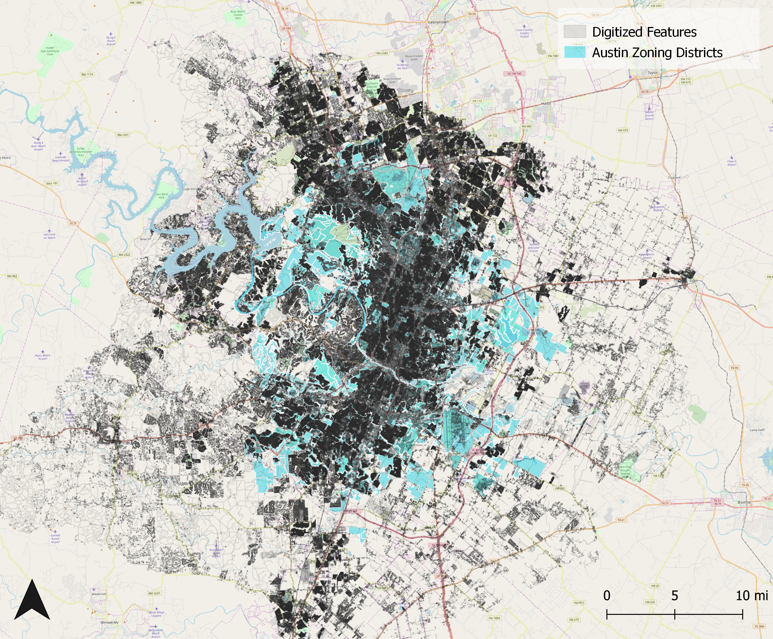
Black:
n = 2,410,915
Manually labelled urban features
Blue:
n = 21,837
Austin Zoning District Boundaries

Slide 5
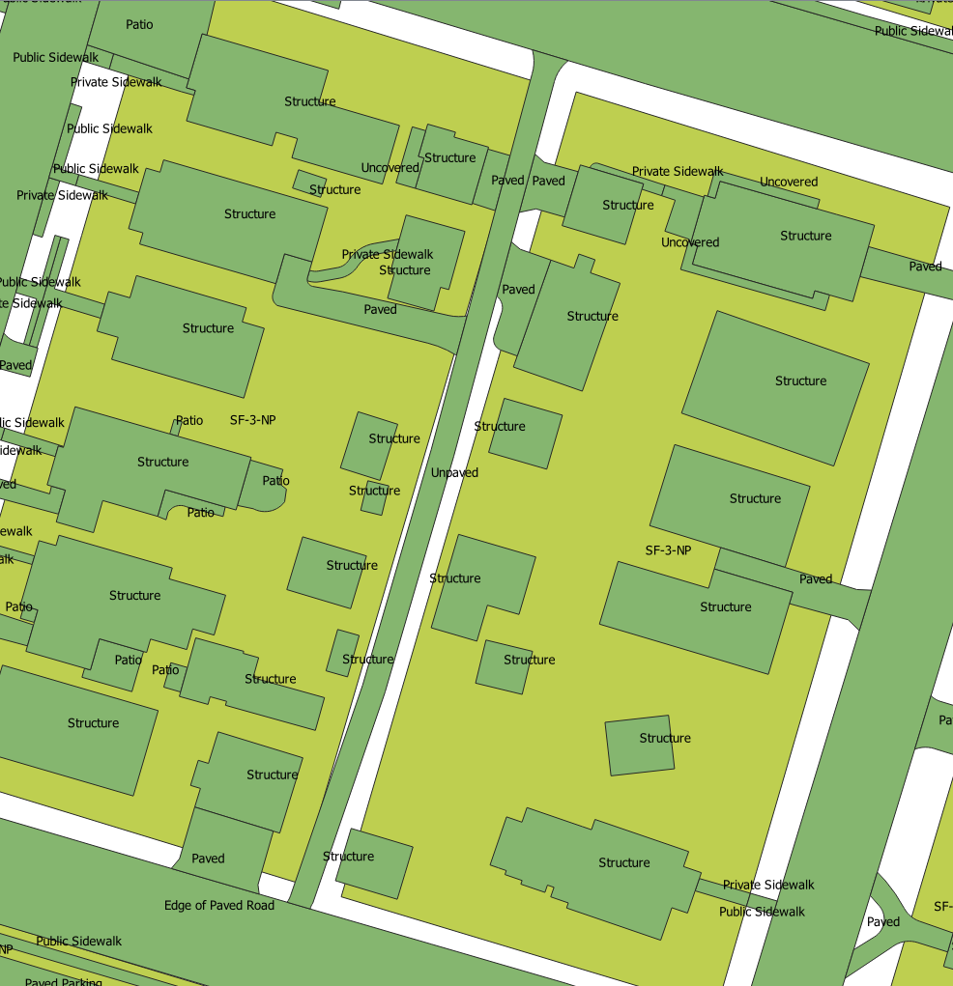
Data Processing Workflow
Issues
Features that are very long cannot be used
Processing time is too long to “cut” each polygon feature to each zone
Did not have time to find faster processing method
Only took features where the area is smaller than the zone area
Use QGIS for feature generation:
For every zone
Count number of features for each unique class
Calculate total area for each class
Example:
Commercial Zone
6 structures
Area (Structure) / Area of Zone = 10%

Slide 6
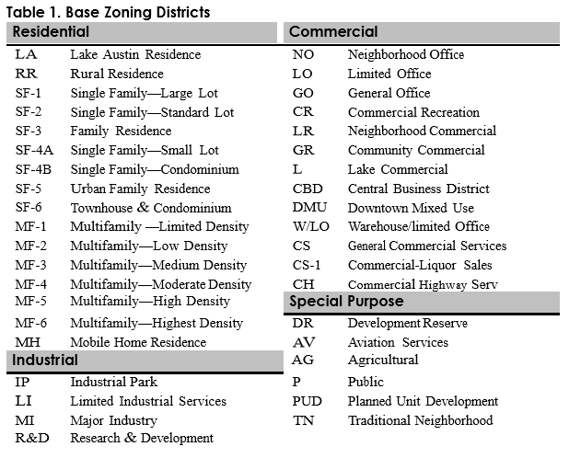
Feature Selection
Used Jupyter Notebook for Data Analysis and Exploration
Raw data contains |X| = 66 features
Contains |Y| = 39 different labels
Reduce 39 different labels down to 4 categories |Y| = 4
Can the set of features be reduced?

Slide 7
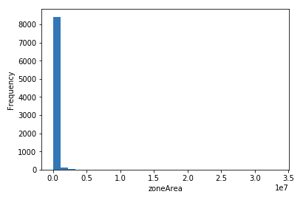
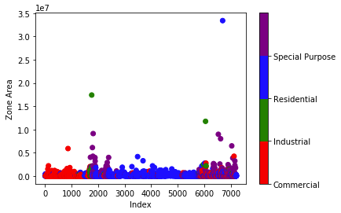
Data Exploration and Analysis
Imbalanced Dataset (7219 instances)
Residential – 4321
Commercial – 2195
Special Purpose – 615
Industrial – 88
Power Law Relationship – Many small zones, very few large zones
Many features (60 different) with various relationships
Power Law Distribution
Outliers

Slide 8
Data Exploration and Analysis
Top 10 Features for each Zone Ranked High to Low (Count):
Residential (Structure, Patio, Sidewalk, Uncovered Deck, Pavement, In Ground Pool, Paved Driveway, Covered Deck, Unpaved Driveway, Courtyard)
Commercial (Structure, Sidewalk, Pavement, Patio, Uncovered Deck, Paved Driveway, Unpaved Driveway, In Ground Pool, Courtyard, Paved Parking)
Industrial (Pavement, Sidewalk, Structure, Patio, Tank, Paved Parking, Paved Driveway, Uncovered Deck, Courtyard, Open Storage)
Special Purpose (Structure, Pavement, Sidewalk, Patio, Paved Driveway, Uncovered Deck, Courtyard, Paved Parking, Open Space, In Ground Pool)
Top 10 Features for each Zone Ranked High to Low (Area):
Residential (Structure, Patio, Sidewalk, Uncovered Deck, Paved Driveway, Pavement, In Ground Pool, Unpaved Driveway, Paved Parking, Unpaved Athletic Field)
Commercial (Structure, Patio, Sidewalk, Pavement, Paved Parking, Unpaved Parking, Uncovered Deck, Paved Driveway, Open Storage, Unpaved Driveway)
Industrial (Structure, Paved Parking, Pavement, Sidewalk, Patio, Compacted Soil, Unpaved Parking, Open Storage, Unpaved Athletic Field, Gravel/Sandpit)
Special Purpose (Structure, Unpaved Athletic Field, Patio, Sidewalk, Pavement, Paved Driveway, Paved Parking, Recreation Field, Compacted Soil, Open Storage)
We know there are SOME identifiers for each zone. How do we know the model will pick these up?

Slide 9
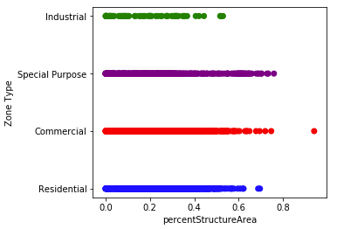
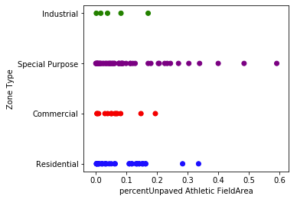
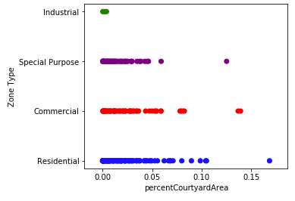
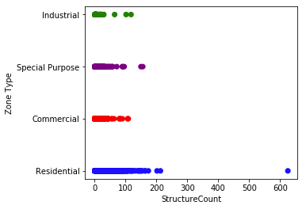
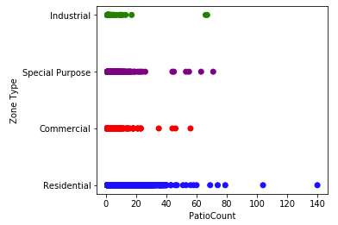
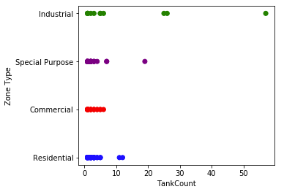
Data Exploration and Analysis
Structure
Unpaved Athletic Field (%Area)
Courtyard (%Area)
Patio (Count)
Tank (Count)
There are some identifiers, but not many unique.
There exists features in all labels (ex: Res, Comm, Special, and Industrial all have Tanks)
Too many features to look at all relationships.

Slide 10
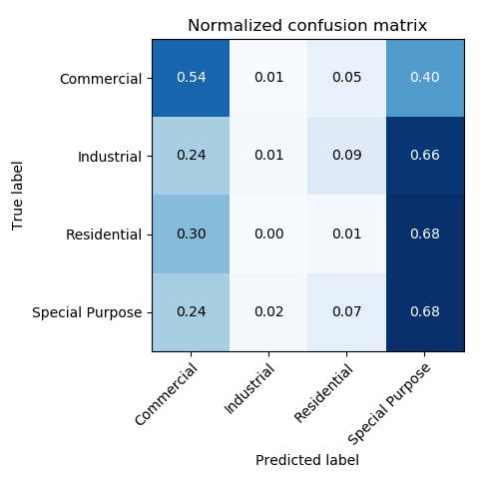
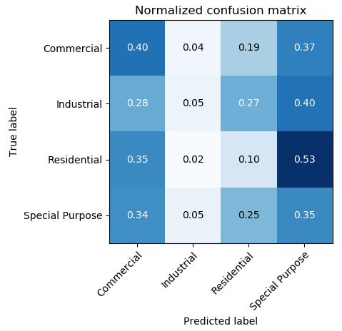
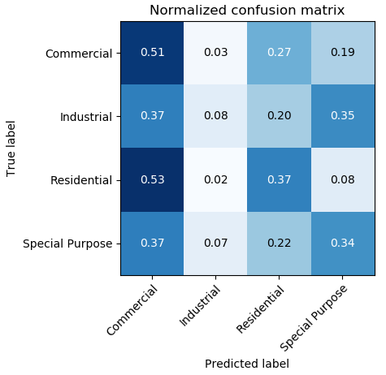
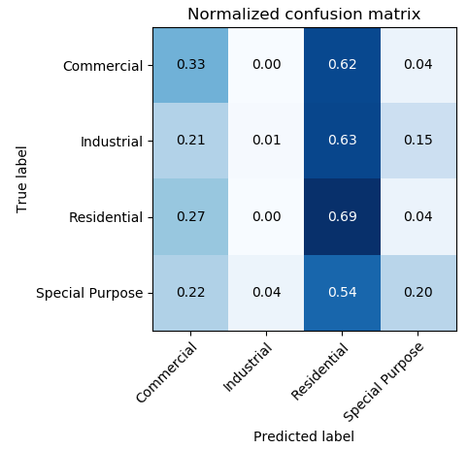
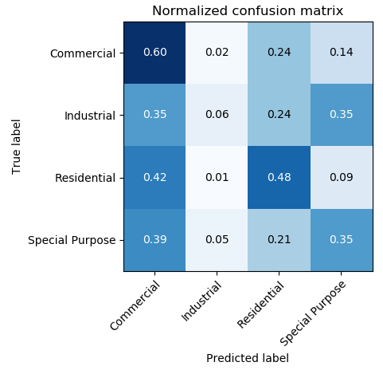
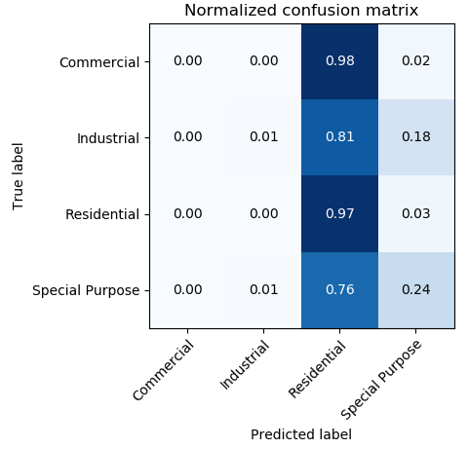
Results
Parameters:
Geometric Predicate:
“contains”
Feature Area / Zone Area
Feature Count
Random Forest
(n=100 estimators)
Decision Tree
(Gini)
Decision Tree
(entropy)
Support Vector
kNN
(k=4)
Ensemble
(Balanced Voting Classifier:
Random Forest,
Decision Tree (entropy)
KNN)

Slide 11
Discussion
Models do not classify Industrial zones very well
Imbalanced dataset, only 88/7219 (1.2%) are classified as Industrial Zones
Many features are present in all classes
Is it reasonable to weight certain features in order to have them classify more Industrial Zones?
Need to get a more accurate number for %Area
Ran into processing time issue for “clipping” every feature (2.4 million features) to every zone (21k)
Consider more feature selection
Remove redundant features and select important features
Learn more about parameters for data mining/machine learning models to increase accuracy
Other performance measures

